Slide 1


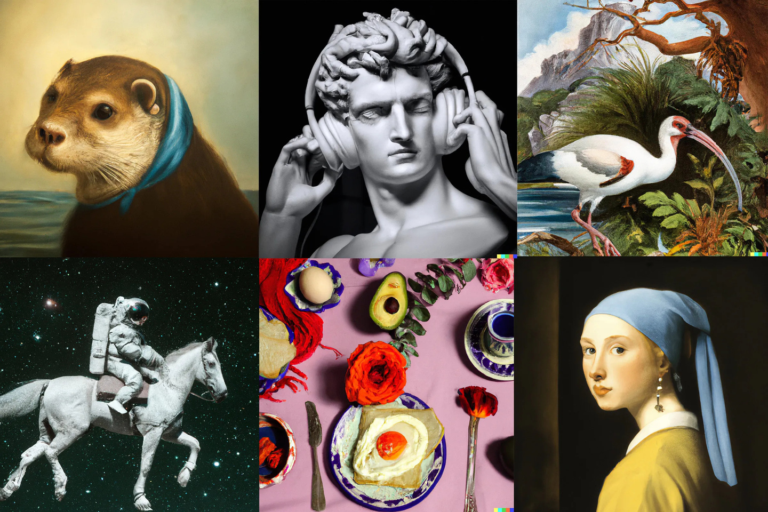


Diffusion models
From Noise to Creativity
Supervised by: Pr. EL Habib BEN LAHMAR
Realized by: AMGHAR Hind
Notes:
Generative models are a type of machine learning model designed to generate new data similar to the data they are trained on.
They answer the question: "Can a machine create something new that resembles what it has learned?"
Examples of generative models include:
GANs (Generative Adversarial Networks): Known for generating realistic images.
VAEs (Variational Autoencoders): Used for tasks like image reconstruction and generation.
Diffusion Models: The focus of this presentation.
Introduction to Diffusion Models
Diffusion models are a newer type of generative model inspired by physical diffusion processes, where particles spread from areas of high concentration to low concentration.
These models gradually add noise to data, then learn to reverse the process to recover or generate new data.
Their key strengths:
Producing high-quality and detailed images.
Stability in training compared to GANs.
Versatility for various applications (e.g., image synthesis, audio generation).
Purpose of the Presentation
The goal is to provide:
Conceptual intuition about what diffusion models are and how they work.
A look into the mathematical principles that underpin them.
An understanding of how they are trained and used to generate data.

Slide 2
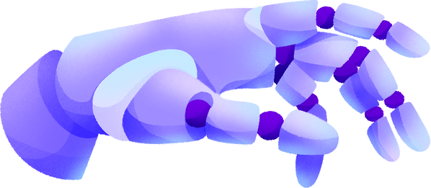


Plan
Introduction
01
Stable Diffusion Model
09
The Foundations
02
Atelier
10
Diffusion Models.
03
The Diffusion Process
04
Mathematical Formulation of VAEs
05
U-Net Architecture
06
SDEs and score matching
07
Training Process of Diffusion Models
08

Slide 3

Introduction
Generative models are a type of machine learning model designed to generate new data similar to the data they are trained on.
They answer the question: "Can a machine create something new that resembles what it has learned?"
Examples of generative models include:
GANs (Generative Adversarial Networks)
VAEs (Variational Autoencoders): Used for tasks like image reconstruction and generation.
Diffusion Models.

Slide 4
The Foundations
Autoencoders
Latent Space
Variational AutoEncoders (VAEs)

Slide 5
The Foundations
Autoencoders
What is an Autoencoder?
Definition:
An Autoencoder is a type of neural network architecture designed to learn a compact representation of data through two key components:
Encoder: Compresses the input data into a smaller-dimensional representation.
Decoder: Reconstructs the original data from the compressed representation.
Key Idea: By training these two components together, Autoencoders learn to extract the most essential features of data, enabling efficient storage and manipulation of information.

Slide 6
The Foundations
Autoencoders
How Do Autoencoders Work?
Data Flow:
The encoder compresses high-dimensional input (e.g., an image) into a low-dimensional latent space.
The decoder attempts to reconstruct the input from the latent space.
Objective: Minimize the reconstruction error: the difference between the original input and the reconstructed output.
Self-Supervised Learning: Autoencoders learn directly from the input by treating it as both the input and the target.

Slide 7
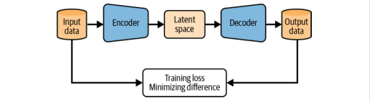
The Foundations
Autoencoders
AutoEncoder architecture ?

Slide 8
The Foundations
Latent Space
What is Latent Space?
Definition :
Latent space is a compressed, abstract representation of data learned by a model.
It encodes the most essential features of the input in a lower-dimensional space.
The latent space is often represented as a vector of numbers .
Why is Latent Space Important?
Compresses high-dimensional data into a smaller vector.
Captures the structure of the data (e.g., shape, color, texture for images).
Data Manipulation: data interpolation, generation, and clustering.

Slide 9
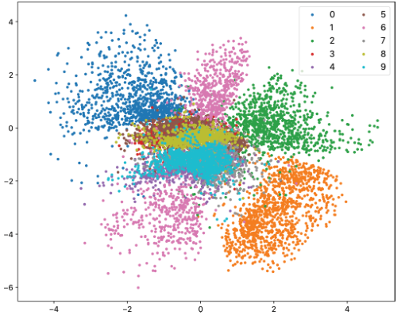
The Foundations
Latent Space
Latent space representation
Similar digits (e.g., 1 and 7, 8 and 9) are close to each other, the latent space encodes shared features.
Overlapping clusters (e.g., 4 and 9) indicate that the model might struggle to differentiate those digits.

Slide 10

The Foundations
Variational AutoEncoders
(VAEs)
Limitations of Standard AutoEncoders ?
Unstructured Latent Space:
In standard AutoEncoders, the latent space is not constrained to any particular distribution.
The encoded points for similar data samples may overlap, leaving empty and inconsistent regions in latent space.
No Control Over Generative Process:
AutoEncoders cannot enforce structured relationships between features in the latent space.

Slide 11
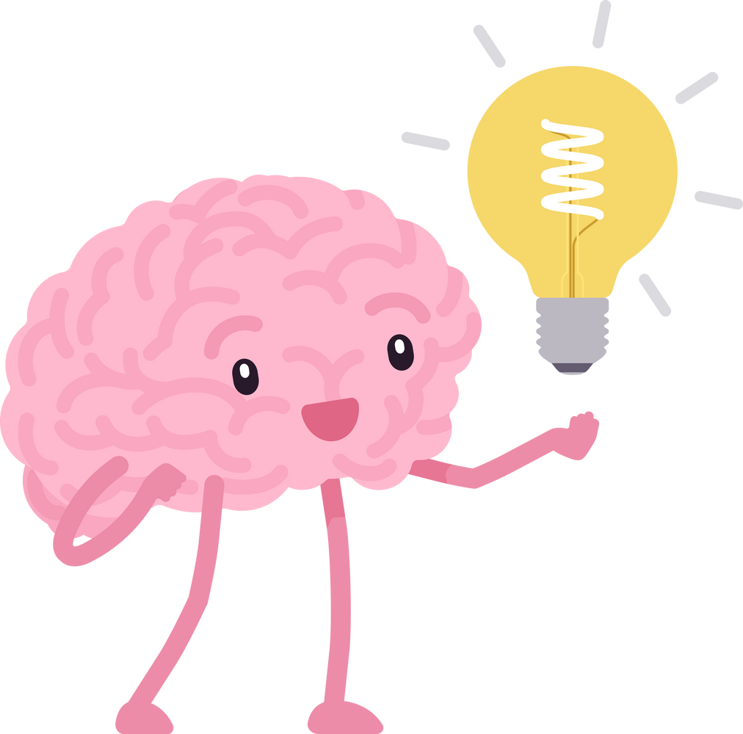

The Foundations
Variational AutoEncoders
(VAEs)
How VAEs Address These Limitations ?
Imposing a Distribution:
VAEs constrain the latent space to follow a Gaussian distribution for each encoded feature.
Instead of mapping an input to a single point, the encoder predicts the mean and log-variance of a Gaussian distribution for each feature.

Slide 12
The Foundations
Variational AutoEncoders
(VAEs)
How VAEs Address These Limitations ?
Example
Imagine you're encoding images of cats and dogs:
AutoEncoders may randomly place encoded points for cats and dogs in the latent space, leading to overlap or empty regions.
VAEs ensure that these encoded points form structured distributions. For instance:
A "cat ear" feature might have a Gaussian distribution capturing all possible ear shapes.
Sampling from this distribution creates realistic variations of cat images.

Slide 13
Diffusion Models
introduction
What are Diffusion Models?
A class of probabilistic models that generate data by adding noise and gradually denoising it.
Inspired by stochastic processes in physics.
Why Diffusion Models?
More stable than GANs (no mode collapse).
Higher quality and diversity in image generation.

Slide 14
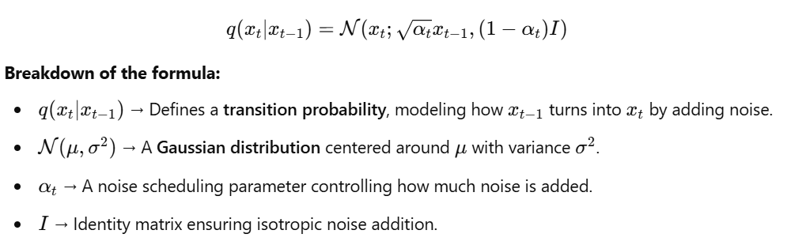
Understanding the Diffusion Process
Mathematical Representation
Forward Diffusion Process (Noise Addition)
Diffusion models are based on a Markov chain, where a clean data sample x_0 undergoes gradual corruption:

Slide 15
Understanding the Diffusion Process
Mathematical Representation
Forward Diffusion Process (Noise Addition)
Why do we use Gaussian noise?
The Central Limit Theorem justifies that many natural transformations result in Gaussian noise.
Gaussian noise is mathematically convenient for diffusion because it is easy to manipulate and compute.

Slide 16
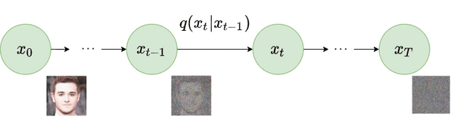
Understanding the Diffusion Process
Mathematical Representation
Forward Diffusion Process (Noise Addition)

Slide 17
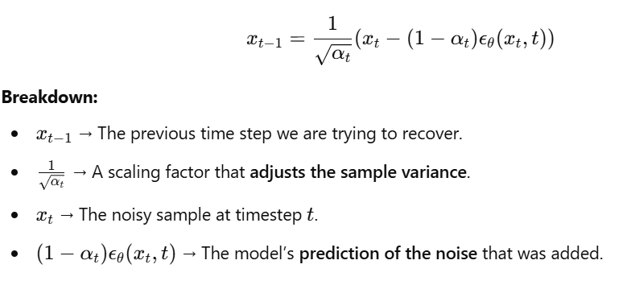
Understanding the Diffusion Process
Mathematical Representation
Reverse Diffusion Process (Denoising)
To generate new samples, we reverse the noising process:

Slide 18
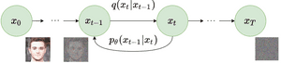
Understanding the Diffusion Process
Mathematical Representation
Reverse Diffusion Process (Denoising)

Slide 19
Mathematical Formulation of VAEs
Mathematical Representation
KL Divergence in VAEs
VAEs improve autoencoders by enforcing a structured latent space. Instead of learning a fixed encoding, we assume that the latent variable zzz follows a probabilistic distribution.
We want the encoded latent representation to follow a standard normal distribution p(z)=N(0,I). This ensures that generated samples are smooth.

Slide 20
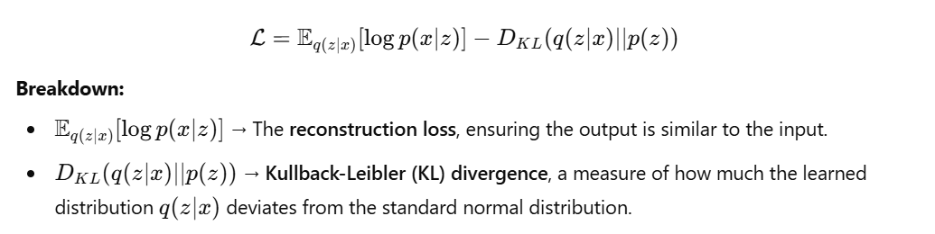
Mathematical Formulation of VAEs
Mathematical Representation
KL Divergence in VAEs

Slide 21
Mathematical Formulation of VAEs
Mathematical Representation
KL Divergence in VAEs
Why do we need KL divergence?
Ensures smooth sampling by making sure our latent space follows a Gaussian distribution.
Encourages generalization instead of memorization.

Slide 22
U-Net Architecture
reverse diffusion process
what is U-Net?
U-Net is a convolutional neural network (CNN) designed for denoising and segmentation tasks. In diffusion models, U-Net plays a crucial role in the reverse diffusion process, progressively removing noise from corrupted images.

Slide 23
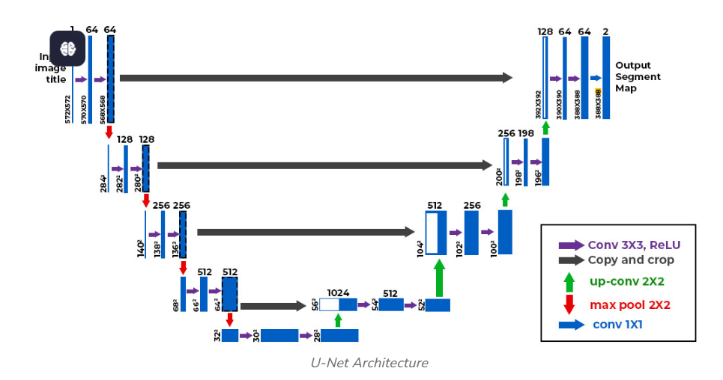
U-Net Architecture
reverse diffusion process
what is U-Net?

Slide 24
U-Net Architecture
Mathematical Representation
Downsampling Path (Encoder)
What Does It Do?
The encoder extracts hierarchical features from the input image, capturing spatial and semantic information at multiple levels.
Each layer in the encoder consists of convolutional operations, activation functions, and downsampling to progressively reduce the image resolution.

Slide 25
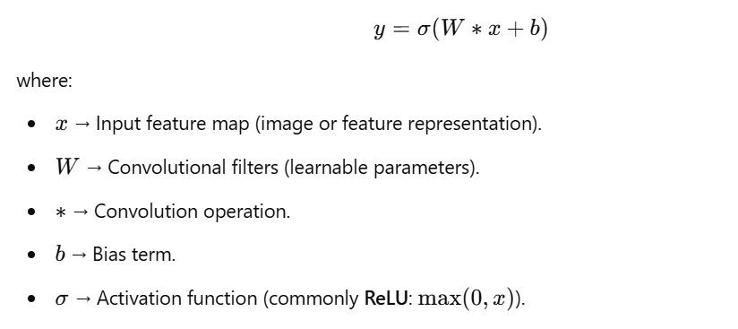
U-Net Architecture
Mathematical Representation
Downsampling Path (Encoder)
Mathematical Formulation
At each layer,
a convolutional
operation is applied:

Slide 26
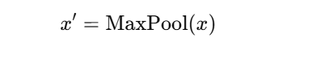
U-Net Architecture
Mathematical Representation
Downsampling Path (Encoder)
After convolution, downsampling (pooling) reduces the spatial dimensions:
where:
MaxPool() → Takes the maximum value in small patches (e.g., 2×2) to retain the most significant features while reducing dimensions.

Slide 27
U-Net Architecture
Mathematical Representation
Purpose of the Encoder in Diffusion Models
Captures important low-level (edges, textures) and high-level (object shapes) features.
Reduces computational complexity by compressing the image into a latent representation.

Slide 28
U-Net Architecture
Mathematical Representation
Bottleneck Layer
What Does It Do?
The bottleneck is the deepest part of the U-Net, where the spatial resolution is lowest, but the feature representation is richest.
It allows the network to understand the entire image context before reconstruction.

Slide 29
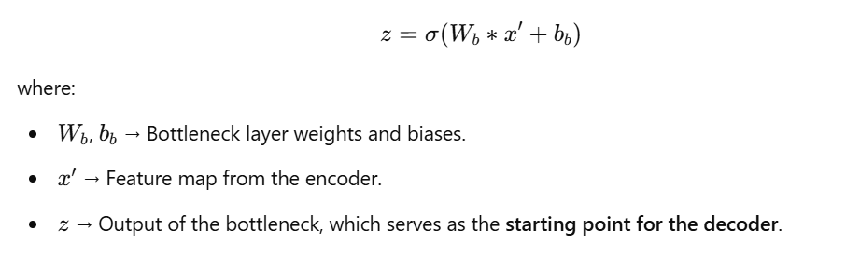
U-Net Architecture
Mathematical Representation
Bottleneck Layer
The bottleneck consists of multiple convolutional layers:

Slide 30
U-Net Architecture
Mathematical Representation
Bottleneck Layer
Purpose in Diffusion Models :
The bottleneck layer compresses the feature maps and helps the model focus on high-level abstractions.
This step helps diffusion models retain the essential structure of the image while removing noise.

Slide 31
U-Net Architecture
Mathematical Representation
Upsampling Path (Decoder)
What Does It Do?
The decoder gradually reconstructs the image by upsampling and refining the feature maps.
It ensures that fine details are recovered.

Slide 32
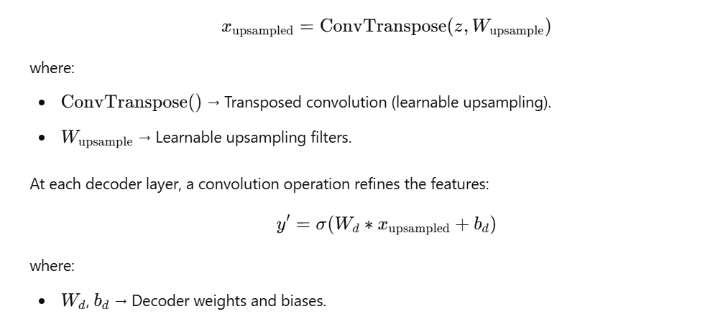
U-Net Architecture
Mathematical Representation
Upsampling Path (Decoder)
Mathematical Formulation
For upsampling, we use
transposed convolution
(deconvolution) to
increase
spatial dimensions:

Slide 33
U-Net Architecture
Mathematical Representation
Upsampling Path (Decoder)
Purpose in Diffusion Models :
The decoder removes noise step by step, refining the image at each stage.
It restores spatial resolution while preserving important features.

Slide 34
U-Net Architecture
Mathematical Representation
Skip Connections
What Do They Do?
Skip connections directly transfer information from the encoder to the decoder.
This preserves fine details that might be lost during downsampling.

Slide 35
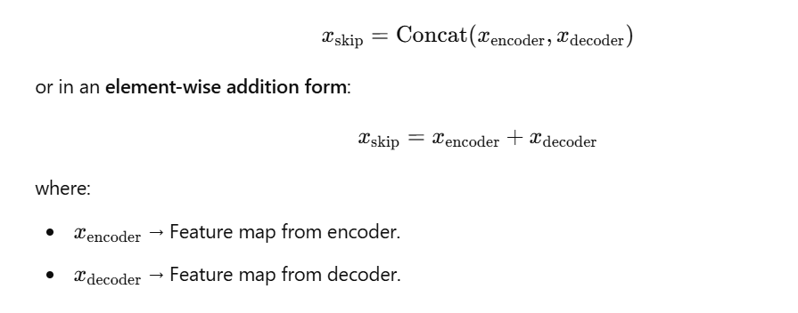
U-Net Architecture
Mathematical Representation
Skip Connections
Mathematical Formulation :
At each layer, the
encoder’s feature
maps are concatenated
with
the decoder’s
corresponding layer:

Slide 36
U-Net Architecture
Mathematical Representation
Skip Connections
Why Are Skip Connections Important?
They help retain fine-grained spatial details that would otherwise be lost.
In diffusion models, this ensures that denoising is accurate at every step.
It also improves gradient flow, making training more stable.

Slide 37
U-Net
Why Is U-Net Used in Diffusion Models?
Capturing Multi-Scale Features
Diffusion models denoise images at multiple levels.
U-Net is designed to capture both low-level and high-level details, making it ideal for diffusion-based denoising.

Slide 38
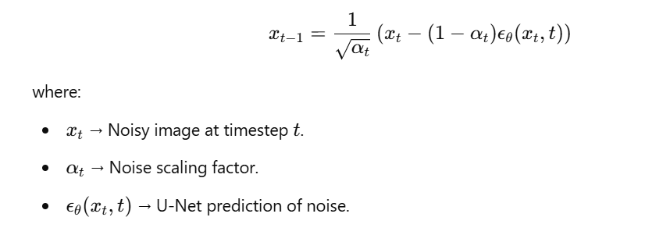
U-Net
Why Is U-Net Used in Diffusion Models?
Efficient Noise Prediction
The U-Net takes in a noisy image and predicts the noise that needs to be removed.
It learns a function ϵθ(xt,t) that estimates the noise at timestep t.

Slide 39
U-Net
Why Is U-Net Used in Diffusion Models?
Stability in Training
Unlike GANs, diffusion models with U-Net are more stable since they do not involve adversarial training.
The hierarchical structure of U-Net allows gradual noise removal, making training easier.

Slide 40
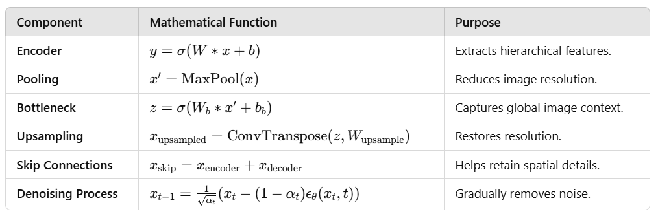
U-Net
Why Is U-Net Used in Diffusion Models?
Summary of U-Net’s Role in Diffusion Models

Slide 41
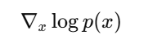
Mathematical Formulation of Diffusion Models
stochastic differential equations (SDEs) and score matching
Score Matching in Diffusion Models
Understanding the Score Function
The goal of a diffusion model is to learn the gradient of the log probability distribution of data:
This function, called the score function, tells us the direction in which data points should be moved to increase their probability under the true data distribution.
Since we do not know p(x), we train a model ϵθ(xt,t) to approximate the noise added at each timestep.

Slide 42
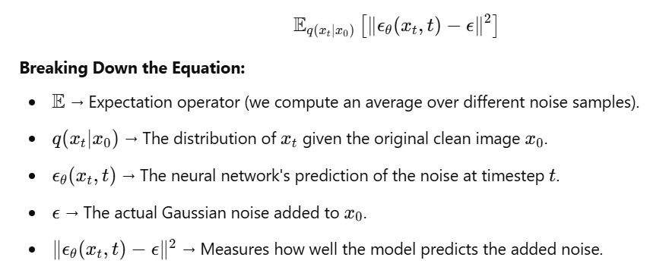
Mathematical Formulation of Diffusion Models
stochastic differential equations (SDEs) and score matching
Score Matching in Diffusion Models
Training Objective for
Score Matching :
Diffusion models are
trained
using the following
loss function:

Slide 43
Mathematical Formulation of Diffusion Models
stochastic differential equations (SDEs) and score matching
Score Matching in Diffusion Models
Why Does This Loss Work?
If ϵθ(xt,t) learns to predict noise correctly, we can subtract this predicted noise from a noisy image to reconstruct a clean sample.
This is a score-based learning approach, where we approximate the true gradient ∇_x ​logp(x).

Slide 44
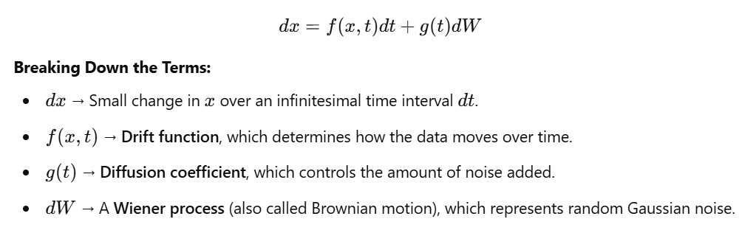
Mathematical Formulation of Diffusion Models
stochastic differential equations (SDEs) and score matching
Stochastic Differential Equations (SDEs)
Forward Diffusion Process (Noising Process)?
Diffusion models define a stochastic process that progressively adds noise to data over time.
This process is governed
by a Stochastic
Differential Equation (SDE):
Describes how an image x becomes progressively noisier as time increases.

Slide 45
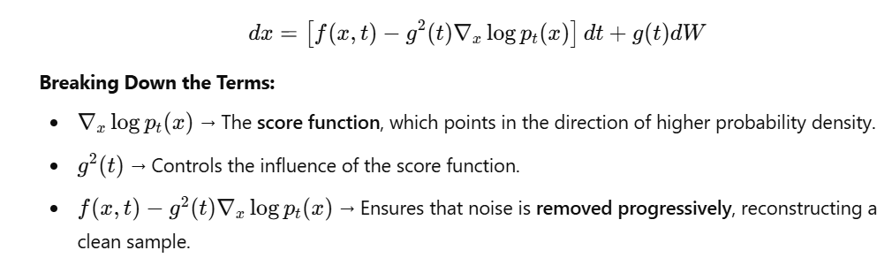
Mathematical Formulation of Diffusion Models
stochastic differential equations (SDEs) and score matching
Stochastic Differential Equations (SDEs)
Reverse Diffusion Process (Denoising)?
To generate new data, we need to reverse the diffusion process. This is done by solving the reverse-time SDE:

Slide 46
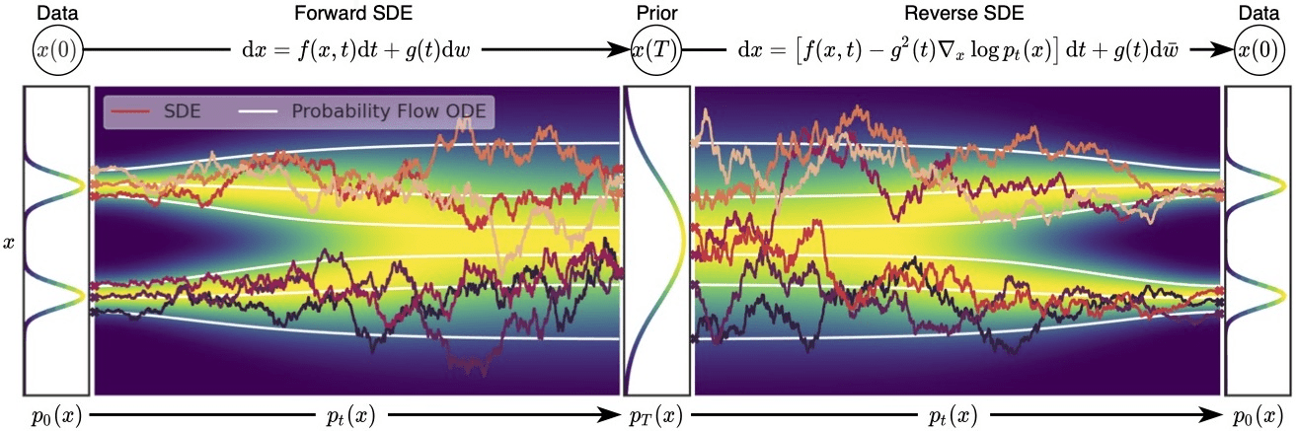
Mathematical Formulation of Diffusion Models
stochastic differential equations (SDEs) and score matching
Stochastic Differential Equations (SDEs)

Slide 47
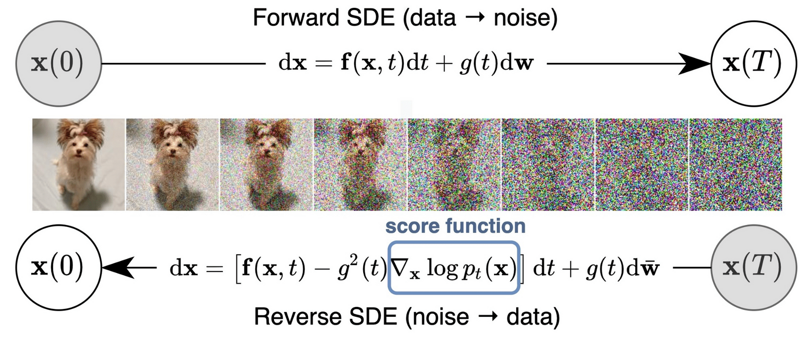
Mathematical Formulation of Diffusion Models
stochastic differential equations (SDEs) and score matching
Stochastic Differential Equations (SDEs)

Slide 48
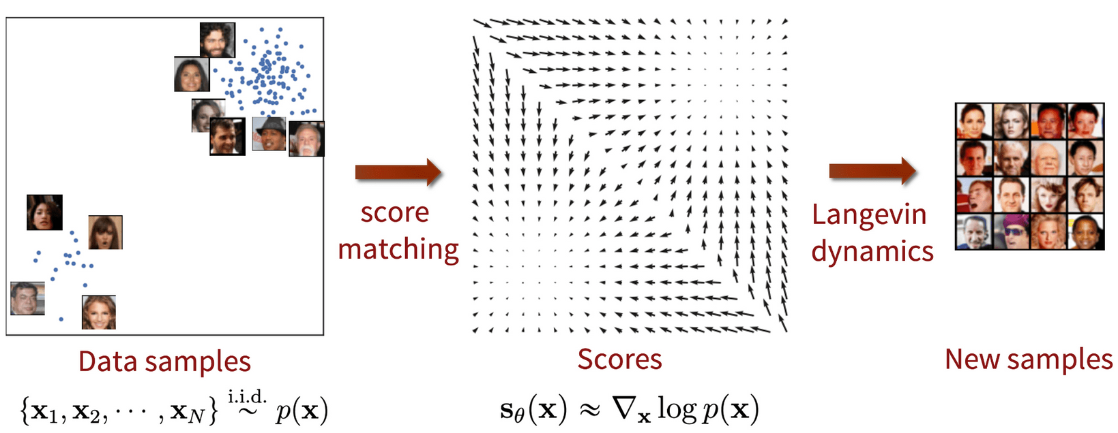
Mathematical Formulation of Diffusion Models
stochastic differential equations (SDEs) and score matching
Stochastic Differential Equations (SDEs)

Slide 49
Mathematical Formulation of Diffusion Models
stochastic differential equations (SDEs) and score matching
Stochastic Differential Equations (SDEs)
How is This Used?
The model learns to predict the score function .
By integrating this reverse SDE over time, we generate clean samples from pure noise.

Slide 50
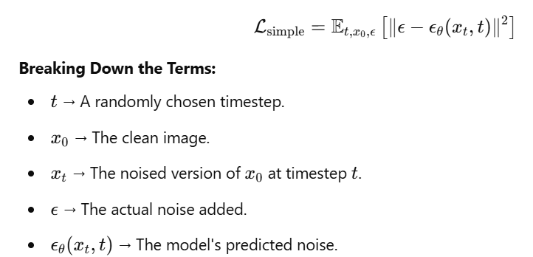
Training Process of Diffusion Models
Training Steps of Diffusion Models
Loss Function for Noise Prediction
The training objective minimizes the difference between the true noise and the model's predicted noise:

Slide 51
Training Process of Diffusion Models
Training Steps of Diffusion Models
Loss Function for Noise Prediction
Why This Loss Function?
If the model learns ϵθ(xt,t)≈ϵ, it can predict the noise added at each step.
We can then subtract the predicted noise from x_t​, progressively restoring the original clean image.

Slide 52
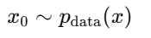
Training Process of Diffusion Models
Training Steps of Diffusion Models
Step 1: Start with Clean Data
We begin with a real sample x_0​ from the training dataset.
This means x_0​ follows the true data distribution.

Slide 53
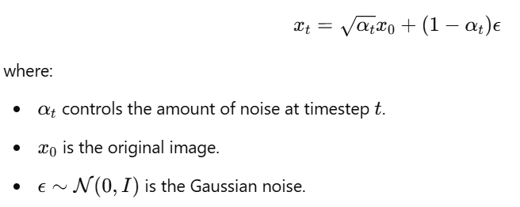
Training Process of Diffusion Models
Training Steps of Diffusion Models
Step 2: Gradually Add Gaussian Noise
To train the model, we apply a forward diffusion process that gradually corrupts the sample:
At higher t, x_t becomes completely random noise.

Slide 54
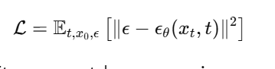
Training Process of Diffusion Models
Training Steps of Diffusion Models
Step 3: Train Model to Predict Noise
The model is trained to take x_t and estimate ϵθ(xt,t).
It minimizes the following mean squared error (MSE) loss:
If the model learns ϵθ(xt,t)≈ϵ, it can accurately remove noise.

Slide 55
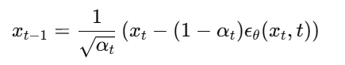
Training Process of Diffusion Models
Training Steps of Diffusion Models
Step 4: Reverse the Process to Generate New Data
Once trained, the model can generate images from pure noise. The reverse process follows:
At each step, the model removes the predicted noise.
The process continues until we reach x_0​, a new generated image.

Slide 56
Training Process of Diffusion Models
Training Steps of Diffusion Models
Step 4: Reverse the Process to Generate New Data

Slide 57
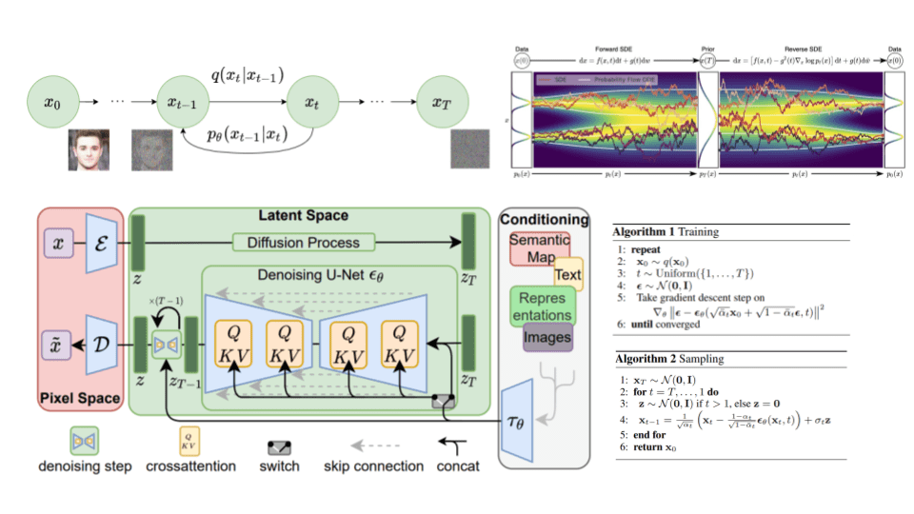
Training Process of Diffusion Models
Training Steps of Diffusion Models

Slide 58
Stable Diffusion Model
Diffusion in the latent space
Why Does Stable Diffusion Use Latent Space Instead of Pixel Space?
Problems with Pixel-Space Diffusion Models
Traditional diffusion models apply noise and denoising directly on pixel images, which is computationally expensive.
Operating in high-dimensional pixel space (512×512 images) requires significant computational power.
Solution: Diffusion in Latent Space
Stable Diffusion first encodes images into a lower-dimensional space using a Variational Autoencoder (VAE). The denoising process then happens in this compressed latent space, making it: More memory efficient ; Faster while preserving high-quality image details.

Slide 59
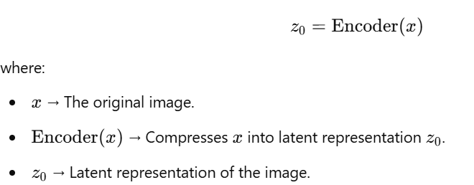
Stable Diffusion Model
Components of Stable Diffusion
1. VAE (Variational Autoencoder) - Compressing Images
Before applying the diffusion process, Stable Diffusion encodes an image into latent space using a Variational Autoencoder (VAE).

Slide 60
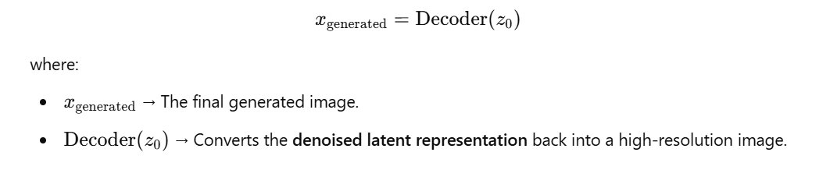
Stable Diffusion Model
Components of Stable Diffusion
1. VAE (Variational Autoencoder) - Compressing Images
Why Use VAE?
Instead of working with large images (512×512), we compress them into smaller representations (64×64).
The decoder reconstructs the final image from the latent space after denoising.

Slide 61
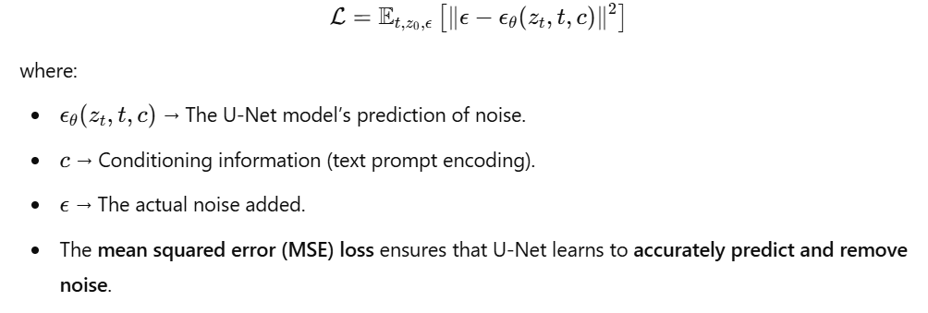
Stable Diffusion Model
Components of Stable Diffusion
2. U-Net Backbone – The Denoising Network
U-Net is the core of Stable Diffusion, responsible for removing noise from latent space representations.
How Does U-Net Work in Stable Diffusion?
Input: Noisy latent variable z_t at timestep t.
Task: Predict the noise component ϵθ​(zt​,t,c).
Output: The model predicts the noise that was added.

Slide 62
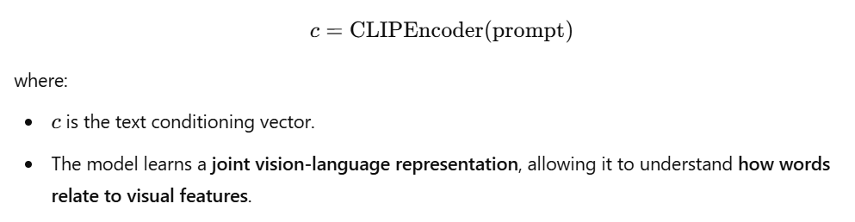
Stable Diffusion Model
Components of Stable Diffusion
3. Text Encoder (Transformer-Based) - Conditioning on Prompts
Stable Diffusion allows image generation to be guided by text prompts. This is achieved using Contrastive Language-Image Pretraining (CLIP).
How Does CLIP Work?
The text prompt (e.g., "A futuristic city at sunset") is converted into a numerical vector representation using CLIP.
The U-Net receives this text embedding as additional information while denoising.

Slide 63
Stable Diffusion Model
Components of Stable Diffusion
3. Text Encoder (Transformer-Based) - Conditioning on Prompts
How Does CLIP Influence Image Generation?
If the prompt is "A dog in a spaceship", the model ensures that the final image aligns with this text.
By conditioning the diffusion process on text embeddings, Stable Diffusion produces images that match the given prompt.

Slide 64
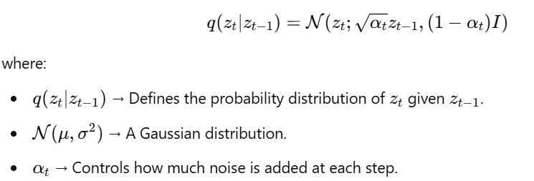
Stable Diffusion Model
Components of Stable Diffusion
4. Scheduler – Controlling the Noise Levels
Diffusion models require precise control over the noise schedule to ensure smooth denoising.
Role of the Scheduler:
Determines how fast noise is removed.
Affects the quality and diversity of generated images.

Slide 65
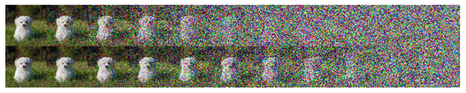
Stable Diffusion Model
Components of Stable Diffusion
4. Scheduler – Controlling the Noise Levels

Slide 66
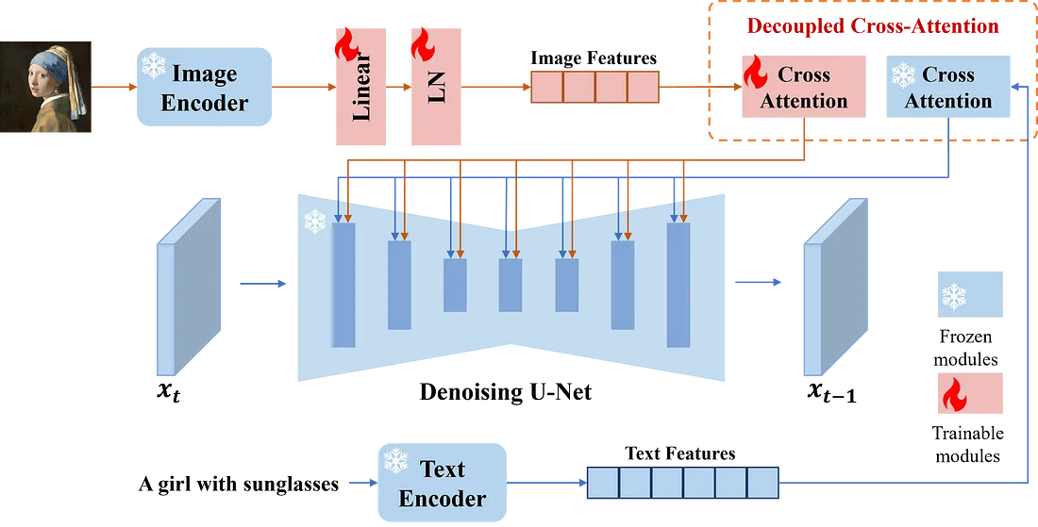
Stable Diffusion Model
Exemple

Slide 67
Stable Diffusion Model
Advantages of Stable Diffusion
Advantages of Stable DiffusionNoise Levels
1. Efficiency
Performs diffusion in latent space instead of pixel space, making it faster and less memory-intensive.
2. Text-to-Image Capabilities
Uses CLIP text encoders to allow precise image generation based on user prompts.
3. Open-Source & Customizable
Unlike models like DALL·E, Stable Diffusion is open-source, allowing users to fine-tune it on custom datasets.

Slide 68
09-01-2025
L’atelier

Slide 69
Conclusion
Diffusion models have revolutionized image generation by leveraging gradual noise addition and removal, they achieve high-quality, diverse, and stable sample generation, outperforming traditional methods like GANs.
Mathematical Rigor: Built on stochastic differential equations (SDEs), score matching, and variational methods, making them theoretically sound.
Denoising as the Core Mechanism: By progressively learning to remove noise, these models effectively reconstruct realistic samples.
U-Net as the Backbone: U-Net plays a critical role in denoising by leveraging skip connections for detail preservation.
Stable Diffusion Optimizes the Process: By shifting diffusion from pixel space to latent space, Stable Diffusion makes generation faster and more efficient while allowing text-to-image control via CLIP.
Why Diffusion Models Matte ?
More Stable Training
High-Quality Image Synthesis
Text-to-Image Capabilities.
Customization and Control

